Slide 1
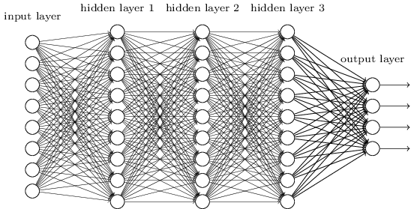
CNN

Slide 2
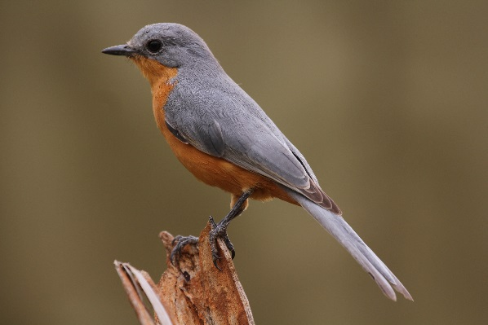
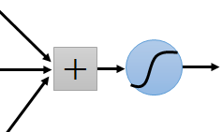
Consider learning an image:
Some patterns are much smaller than the whole image
Can represent a small region with fewer parameters
“beak” detector

Slide 3
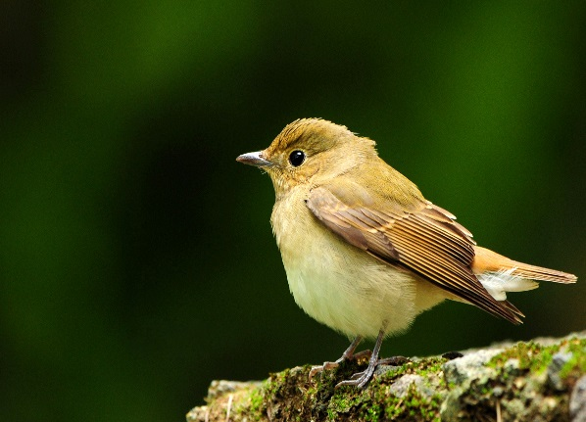
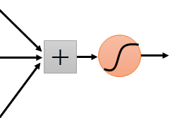
Same pattern appears in different places:

Slide 4
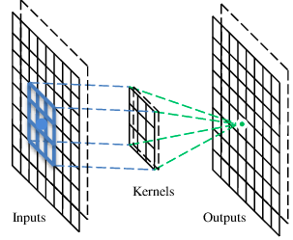
A convolutional layer
A CNN is a neural network with some convolutional layers
(and some other layers). A convolutional layer has a number
of filters that does convolutional operation.
Beak detector
A filter

Slide 5
Convolution
These are the network parameters to be learned.
1 | -1 | -1
-1 | 1 | -1
-1 | -1 | 1
1 | 0 | 0 | 0 | 0 | 1
0 | 1 | 0 | 0 | 1 | 0
0 | 0 | 1 | 1 | 0 | 0
1 | 0 | 0 | 0 | 1 | 0
0 | 1 | 0 | 0 | 1 | 0
0 | 0 | 1 | 0 | 1 | 0
Filter 1
-1 | 1 | -1
-1 | 1 | -1
-1 | 1 | -1
Filter 2
……
6 x 6 image
Each filter detects a small pattern (3 x 3).

Slide 6
Convolution
1 | -1 | -1
-1 | 1 | -1
-1 | -1 | 1
Filter 1
1 | 0 | 0 | 0 | 0 | 1
0 | 1 | 0 | 0 | 1 | 0
0 | 0 | 1 | 1 | 0 | 0
1 | 0 | 0 | 0 | 1 | 0
0 | 1 | 0 | 0 | 1 | 0
0 | 0 | 1 | 0 | 1 | 0
Dot
product
3
-1
6 x 6 image

Slide 7
Convolution
1 | -1 | -1
-1 | 1 | -1
-1 | -1 | 1
Filter 1
1 | 0 | 0 | 0 | 0 | 1
0 | 1 | 0 | 0 | 1 | 0
0 | 0 | 1 | 1 | 0 | 0
1 | 0 | 0 | 0 | 1 | 0
0 | 1 | 0 | 0 | 1 | 0
0 | 0 | 1 | 0 | 1 | 0
3
-3
6 x 6 image

Slide 8
Convolution
1 | -1 | -1
-1 | 1 | -1
-1 | -1 | 1
Filter 1
stride=1
1 | 0 | 0 | 0 | 0 | 1
0 | 1 | 0 | 0 | 1 | 0
0 | 0 | 1 | 1 | 0 | 0
1 | 0 | 0 | 0 | 1 | 0
0 | 1 | 0 | 0 | 1 | 0
0 | 0 | 1 | 0 | 1 | 0
3
-1
-3
-1
-3
1
0
-3
-3
-3
0
1
3
-2
-2
-1
6 x 6 image

Slide 9
Convolution
-1 | 1 | -1
-1 | 1 | -1
-1 | 1 | -1
Filter 2
stride=1
Repeat this for each filter
1 | 0 | 0 | 0 | 0 | 1
0 | 1 | 0 | 0 | 1 | 0
0 | 0 | 1 | 1 | 0 | 0
1 | 0 | 0 | 0 | 1 | 0
0 | 1 | 0 | 0 | 1 | 0
0 | 0 | 1 | 0 | 1 | 0
3
-1
-3
-1
-1
-1
-1
-1
-3
1
0
-3
-1
-1
-2
1
Feature
Map
-3
-3
0
1
-1
-1
-2
1
3
-2
-2
-1
6 x 6 image
-1
0
-4
3
Two 4 x 4 images
Forming 2 x 4 x 4 matrix

Slide 10
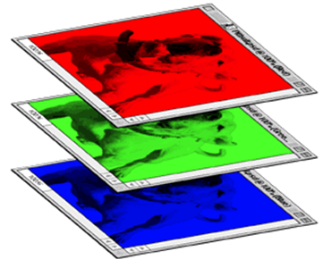
Color image: RGB 3 channels
1 | -1 | -1
-1 | 1 | -1
-1 | -1 | 1
-1 | 1 | -1
-1 | 1 | -1
-1 | 1 | -1
1 | -1 | -1
-1 | 1 | -1
-1 | -1 | 1
-1 | 1 | -1
-1 | 1 | -1
-1 | 1 | -1
1 | -1 | -1
-1 | 1 | -1
-1 | -1 | 1
-1 | 1 | -1
-1 | 1 | -1
-1 | 1 | -1
Filter 1
Filter 2
Color image
1 | 0 | 0 | 0 | 0 | 1
0 | 1 | 0 | 0 | 1 | 0
0 | 0 | 1 | 1 | 0 | 0
1 | 0 | 0 | 0 | 1 | 0
0 | 1 | 0 | 0 | 1 | 0
0 | 0 | 1 | 0 | 1 | 0
1 | 0 | 0 | 0 | 0 | 1
0 | 1 | 0 | 0 | 1 | 0
0 | 0 | 1 | 1 | 0 | 0
1 | 0 | 0 | 0 | 1 | 0
0 | 1 | 0 | 0 | 1 | 0
0 | 0 | 1 | 0 | 1 | 0
1 | 0 | 0 | 0 | 0 | 1
0 | 1 | 0 | 0 | 1 | 0
0 | 0 | 1 | 1 | 0 | 0
1 | 0 | 0 | 0 | 1 | 0
0 | 1 | 0 | 0 | 1 | 0
0 | 0 | 1 | 0 | 1 | 0

Slide 11
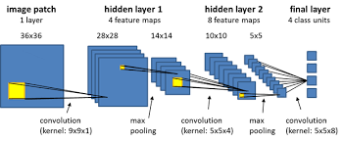

Slide 12
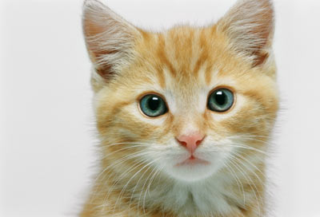

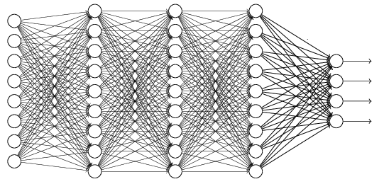





The whole CNN
cat dog ……
Convolution
Max Pooling
Can repeat many times
Fully Connected Feedforward network
Convolution
Max Pooling
Flattened

Slide 13
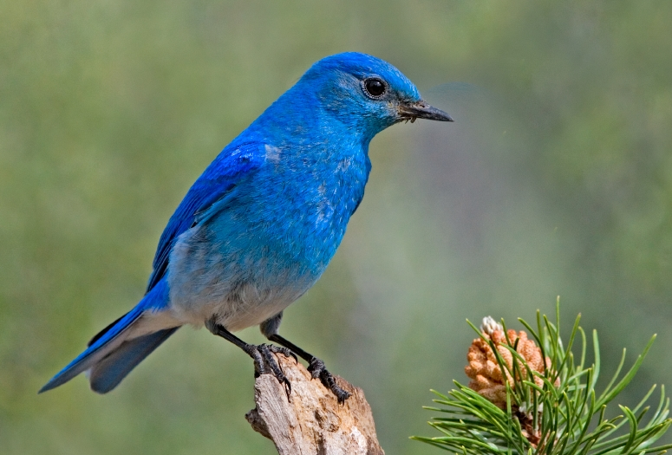

Why Pooling
Subsampling pixels will not change the object
bird
bird
Subsampling
We can subsample the pixels to make image smaller
fewer parameters to characterize the image

Slide 14
A CNN compresses a fully connected network in two ways:
Reducing number of connections
Max pooling further reduces the complexity

Slide 15
Max Pooling
New image
but smaller
1 | 0 | 0 | 0 | 0 | 1
0 | 1 | 0 | 0 | 1 | 0
0 | 0 | 1 | 1 | 0 | 0
1 | 0 | 0 | 0 | 1 | 0
0 | 1 | 0 | 0 | 1 | 0
0 | 0 | 1 | 0 | 1 | 0
Conv
3
0
-1
1
Max
Pooling
3
1
0
3
2 x 2 image
6 x 6 image
Each filter
is a channel

Slide 16

The whole CNN
3
0
-1
1
Convolution
3
1
0
3
Max Pooling
Can repeat many times
A new image
Convolution
Smaller than the original image
The number of channels is the number of filters
Max Pooling

Slide 17



The whole CNN
cat dog ……
Convolution
Max Pooling
Fully Connected Feedforward network
A new image
Convolution
Max Pooling
Flattened
A new image

Slide 18
Thank You!!!
Tarun Varma - 9975252596

